Slide 1
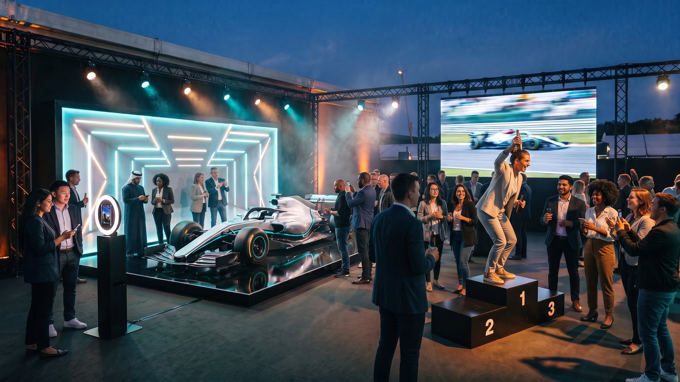
FLASHBULB MEMORIES
F1 FAN EXPERIENCES
PUT EVERY FAN IN THE DRIVER’S SEAT
AI photo, video and print experiences for race weekends, fan zones and brand activations.
Notes:
Open with the idea: fans don’t just look at the car, they leave with themselves in the car, on the grid and on the podium.

Slide 2
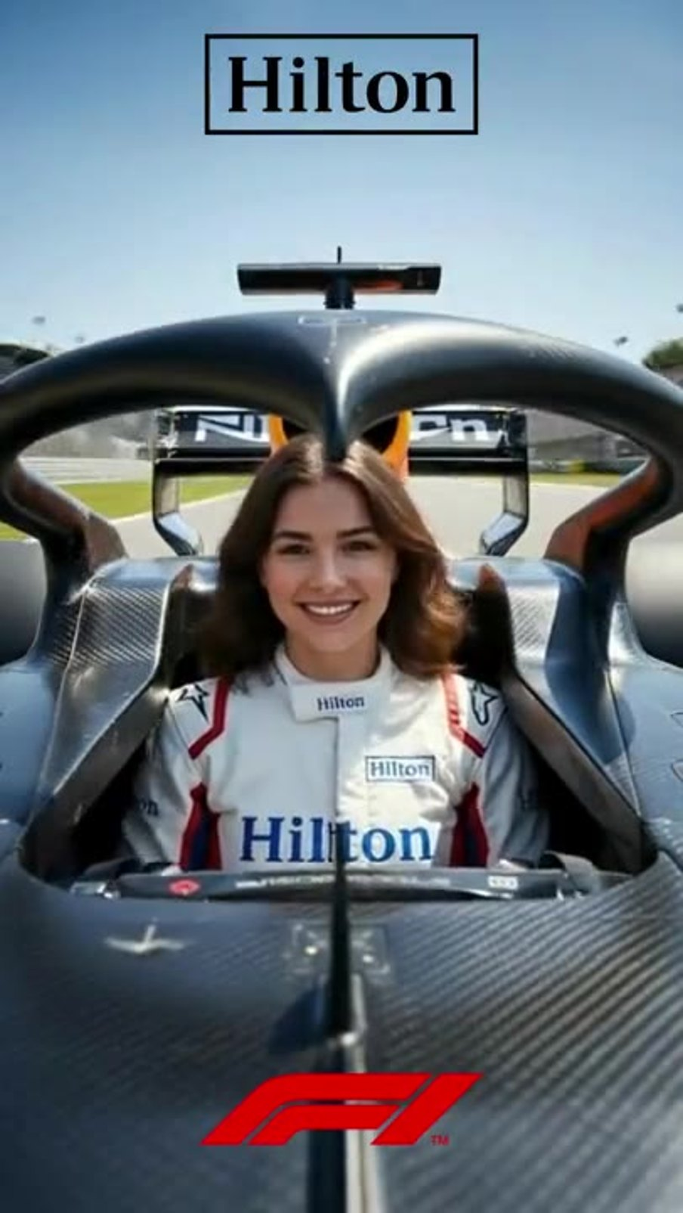
REAL ACTIVATION: F1 AND HILTON, LAS VEGAS
ALREADY ON THE GRID
Guests snapped one photo at a fully branded selfie station. A start-light countdown played on screen, and seconds later they were in the cockpit wearing the partner’s race suit.
Branded from the station screen to the last frame
Partner marks on the suit and in the video
Before and after in one shareable clip
Notes:
Click the video to play it. This is real output from our F1 activation with Hilton in Las Vegas. The same flow can be built around any team or sponsor.

Slide 3
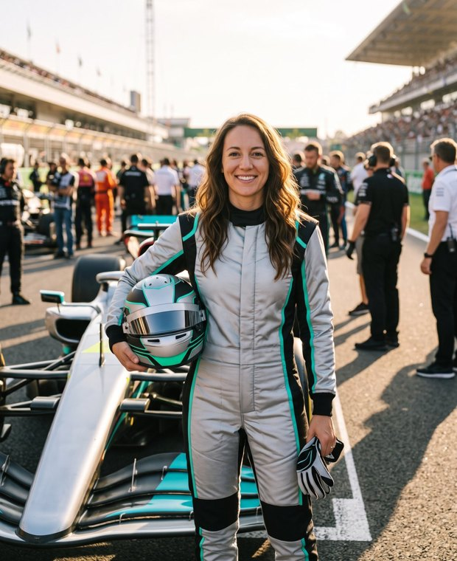
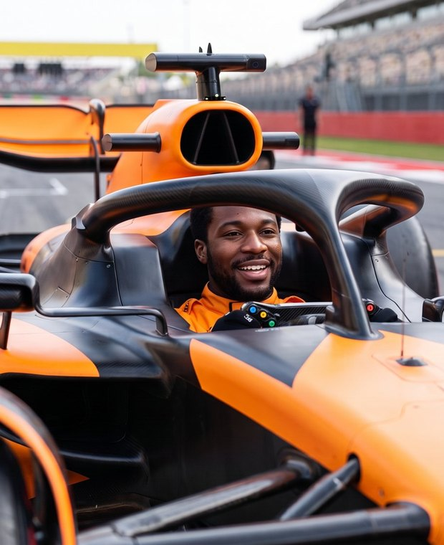
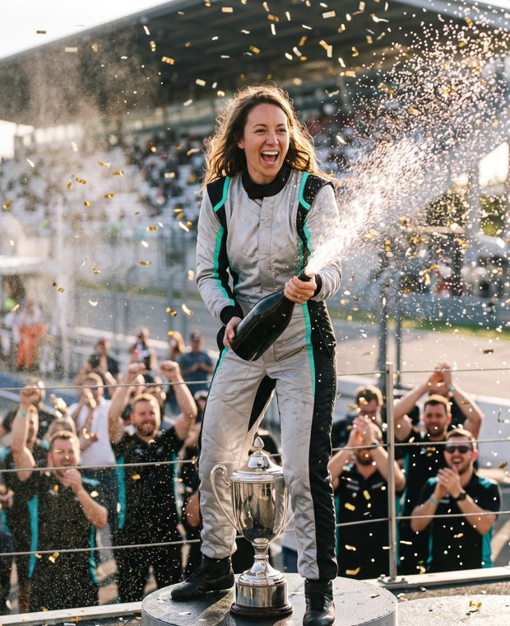
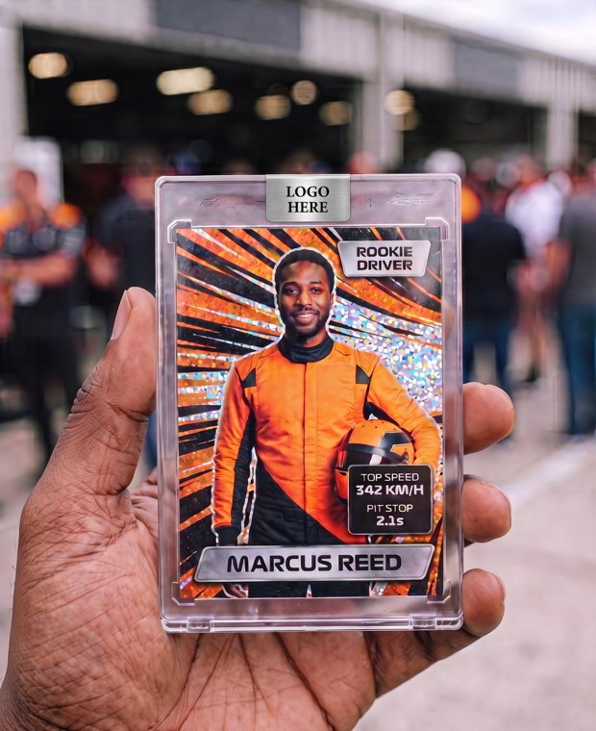
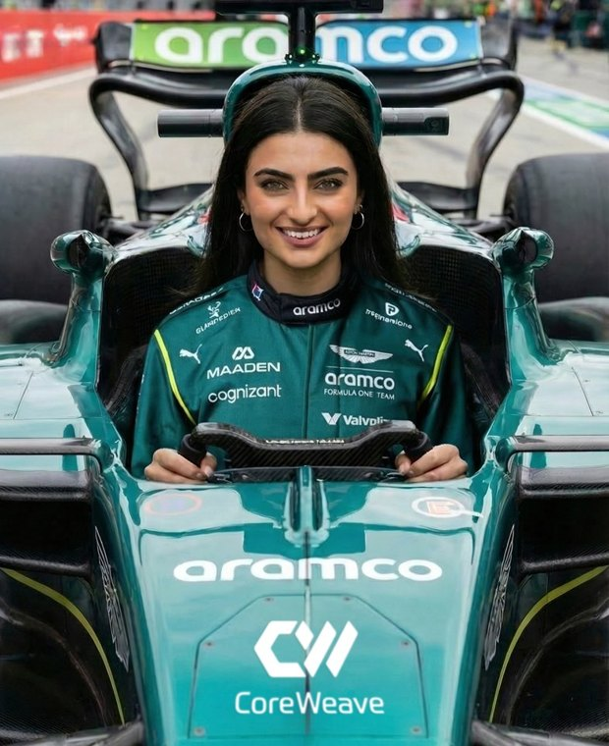
FIVE WAYS TO PUT FANS ON THE GRID
01
02
03
04
05
DRIVER PORTRAIT
COCKPIT HOT LAP
PODIUM MOMENT
TRADING CARDS
TEAM KIT + VIDEO
One photo becomes a suited-up driver shot on the grid.
A video of the guest launching off the line.
Top step, champagne spray and confetti on video.
A printed collectible with their name and stats.
The guest in the team’s real suit and car, photo and video.
Run one, or combine them into a full fan zone.
Notes:
Each concept can run on its own or be combined in one fan zone. Concepts 1 to 4 show example liveries; concept 5 is real output from an event.

Slide 4
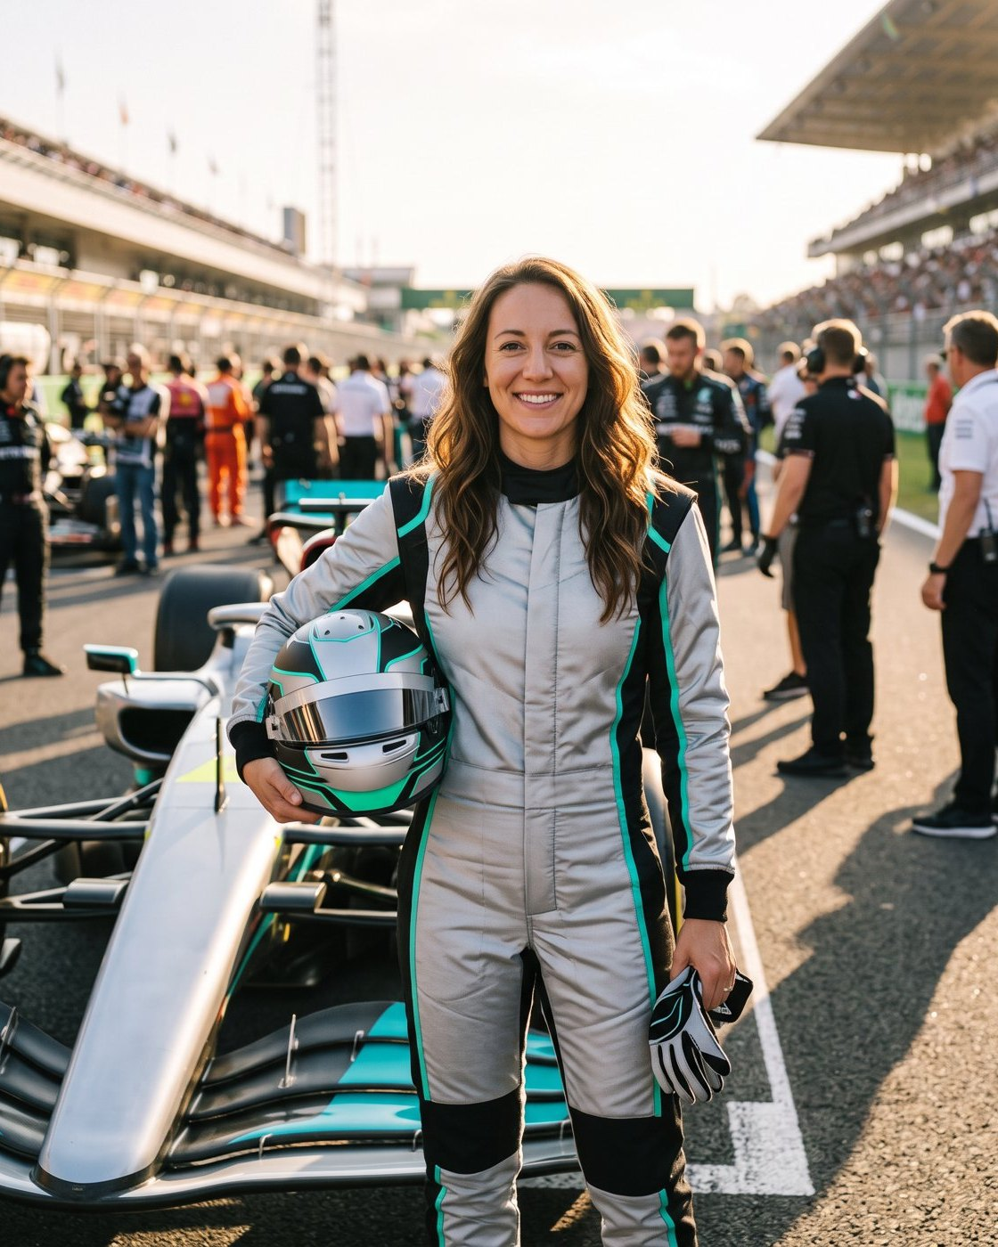
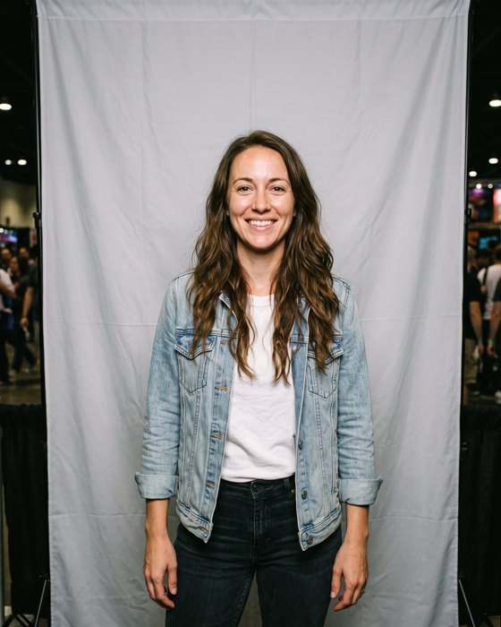
CONCEPT 01
AI DRIVER PORTRAIT
Guests snap one photo and see themselves suited up on the starting grid, helmet under one arm, in your team colors.
Ready on screen in under a minute
Printed on site, plus a text or QR share link
Scenes: starting grid, pit garage, paddock or team wall
Your logos on the suit, the car and the print frame
Walk-up photo
Finished portrait
Notes:
Same face, new world. The suit, car and scene are fully branded per client, and we can offer a few scenes for guests to choose from at the station.

Slide 5
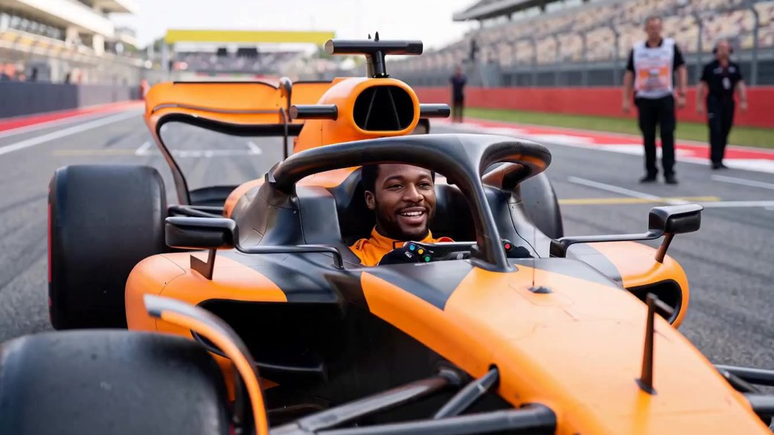
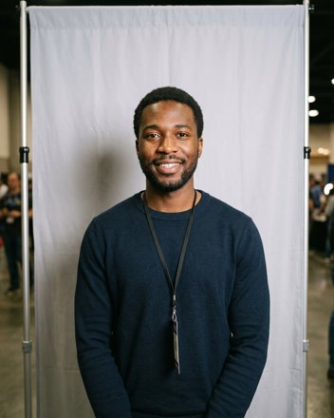
CONCEPT 02
COCKPIT HOT LAP
The guest’s photo turns into a short video of them in the cockpit, grinning under the halo as the car launches off the line.
Vertical or widescreen clip
Renders in the background and arrives by text or QR
Car livery matches your team
Made to be posted on Reels, Stories and TikTok
From one walk-up photo
Notes:
Click the video to play it. The guest never sits in a real car: one photo at the station is all it takes, and the clip is sent to their phone a few minutes later.

Slide 6
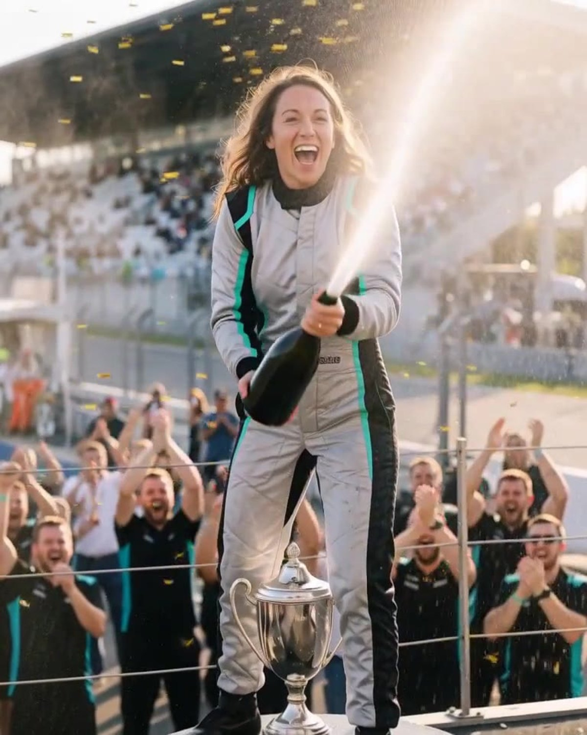

CONCEPT 03
PODIUM MOMENT
Every guest gets the win. Top step, trophy at their feet, champagne spraying at the camera while the crowd goes off.
Video clip or still, guest’s choice
Pairs with a real podium set for the photo op
Suit and backdrop in your colors
Strong end card for your logo and event hashtag
Walk-up photo
Podium video
Notes:
Click the video to play it. This one works well as the closer for a fan zone: the guest leaves the booth with a winner’s clip already on their phone.

Slide 7
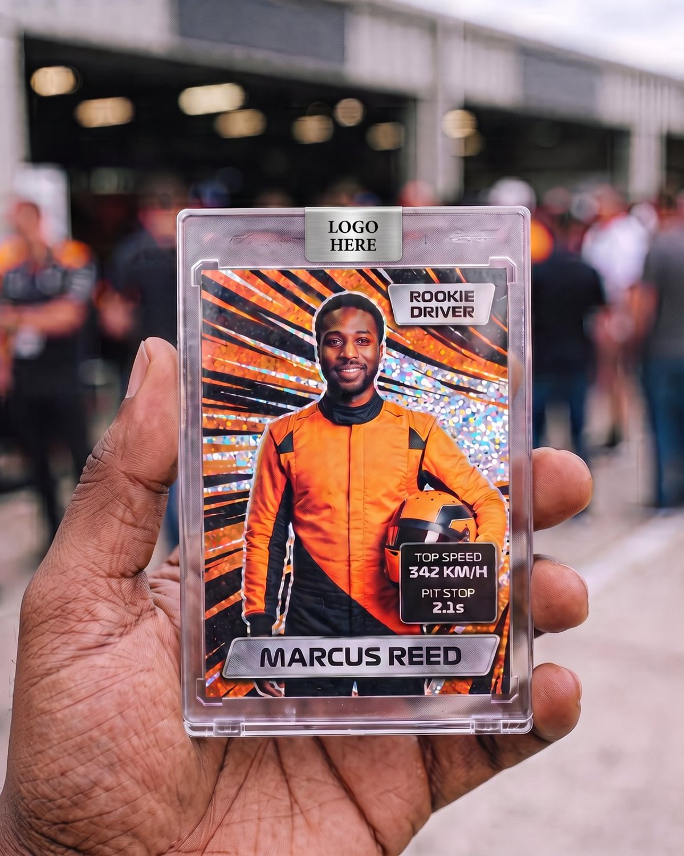
CONCEPT 04
DRIVER TRADING CARDS
A real printed collectible: the guest as a driver, their name on the card and their own stats, sealed in a clear case.
1
Scan to register. Short survey plus card choices like name and number.
2
Scan at the booth to snap. One photo at the selfie station.
3
Print and assemble. The card prints and our team cuts, sleeves and cases it.
Notes:
Registration doubles as lead capture: survey answers and opt-ins come back to the brand after the event. Card designs, stats and the card back are fully custom.

Slide 8
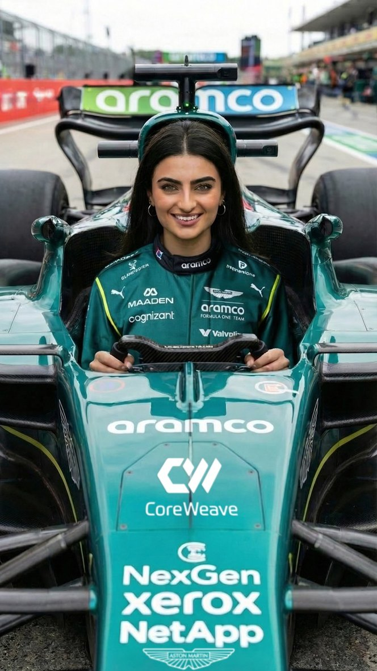
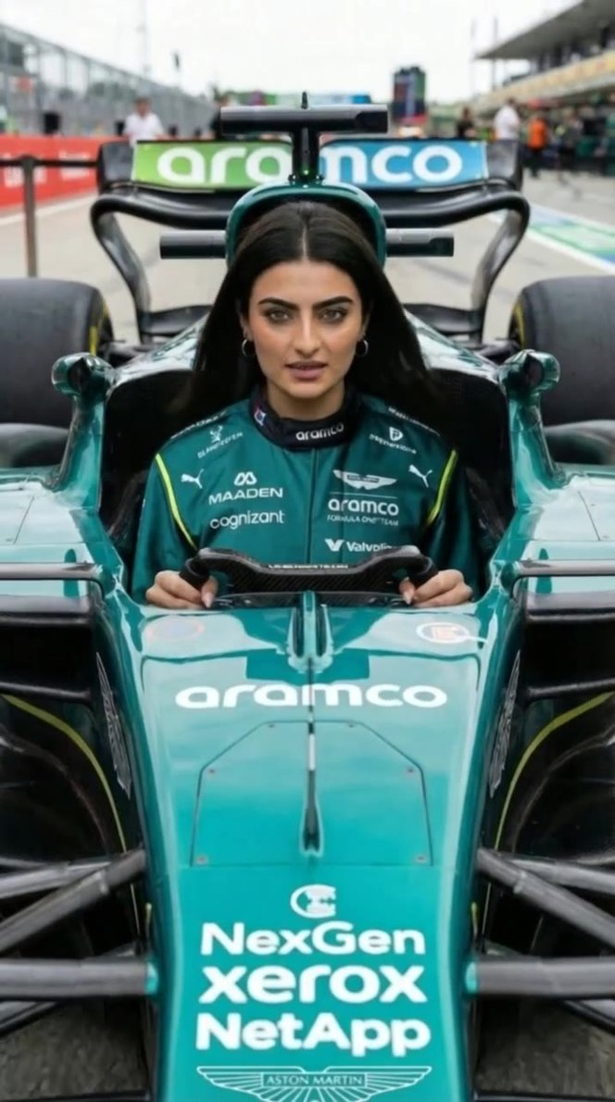
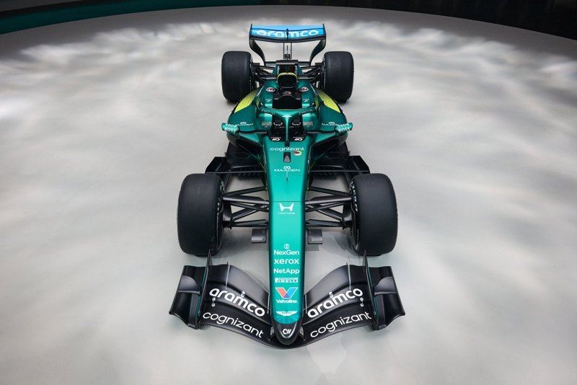
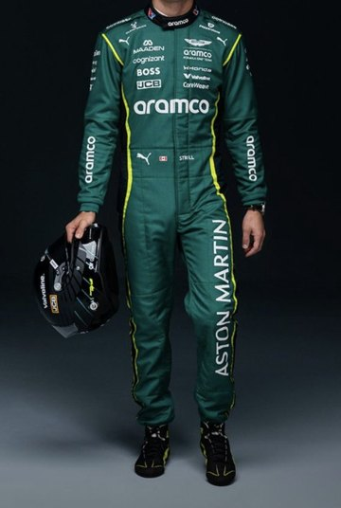
CONCEPT 05 · REAL EVENT OUTPUT
We build the look from the team’s actual race suit and car livery, so every guest shows up in the real kit.
TEAM KIT PHOTO + AI VIDEO
We start from
The real race suit and car
Guest photo in full kit
AI video of the same shot
Notes:
Click the video to play it. This is real output from an F1 team partner activation: we used the team’s race suit and car livery as the reference, and every guest got a photo and a matching video in the real kit.

Slide 9
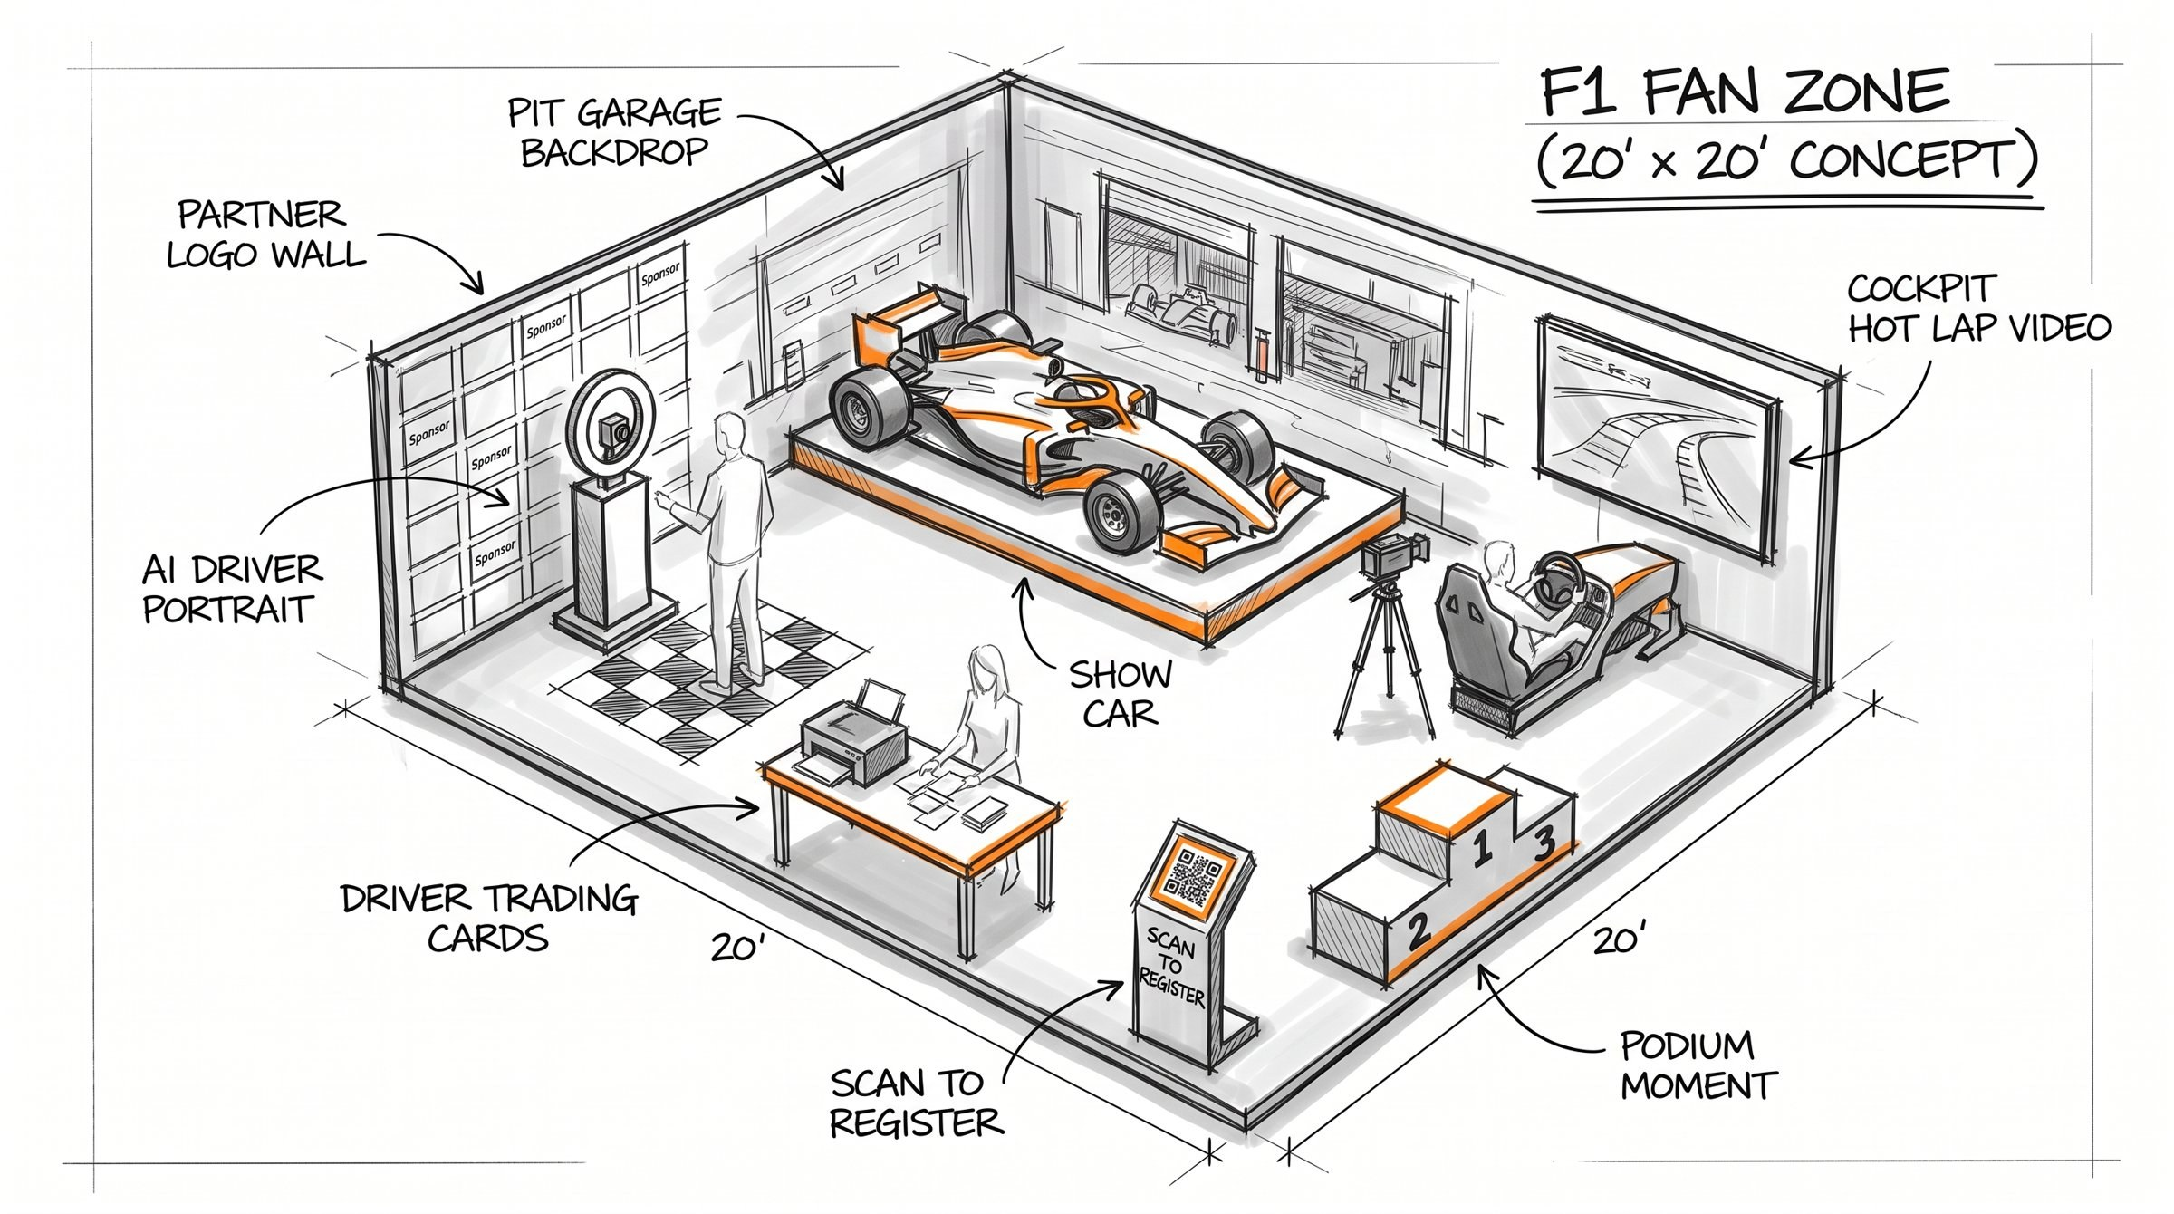
FAN ZONE CONCEPT: 20 X 20 (DRAFT)
Back wall. Pit garage backdrop with the show car on a platform.
Left. Driver portrait station beside the partner logo wall.
Right. Cockpit seat and screen for the hot lap video.
Front. Podium, card assembly table and the register sign.
Notes:
Draft layout on purpose. It scales down to a 10 x 10 with a single station, or up for a full hospitality space. Final layout follows the venue plan.

Slide 10
MOCKUP
Car livery, lighting and wall graphics all follow your brand.
Notes:
This is how the fan zone reads on a race weekend: the car draws people in, the portrait station and podium keep a steady line moving.

Slide 11






HOW IT RUNS ON THE DAY
Registration
Capture
Delivery
Guests scan a QR code, answer your survey and opt in. You get the data after the event.
One photo at the station. No real car or green screen needed for the AI concepts.
Prints and cards on site, photos and videos by text or QR to a branded share page.
Throughput
Footprint
Fully staffed
Up to 180 AI portraits an hour per station. Trading cards run about 80 an hour per station.
From one station in a 10 x 10 up to a full 20 x 20 fan zone.
Our team runs every station, keeps the line moving and handles setup and teardown.
Notes:
Throughput figures are per station. For big crowds we add stations or a second card assembly line.

Slide 12
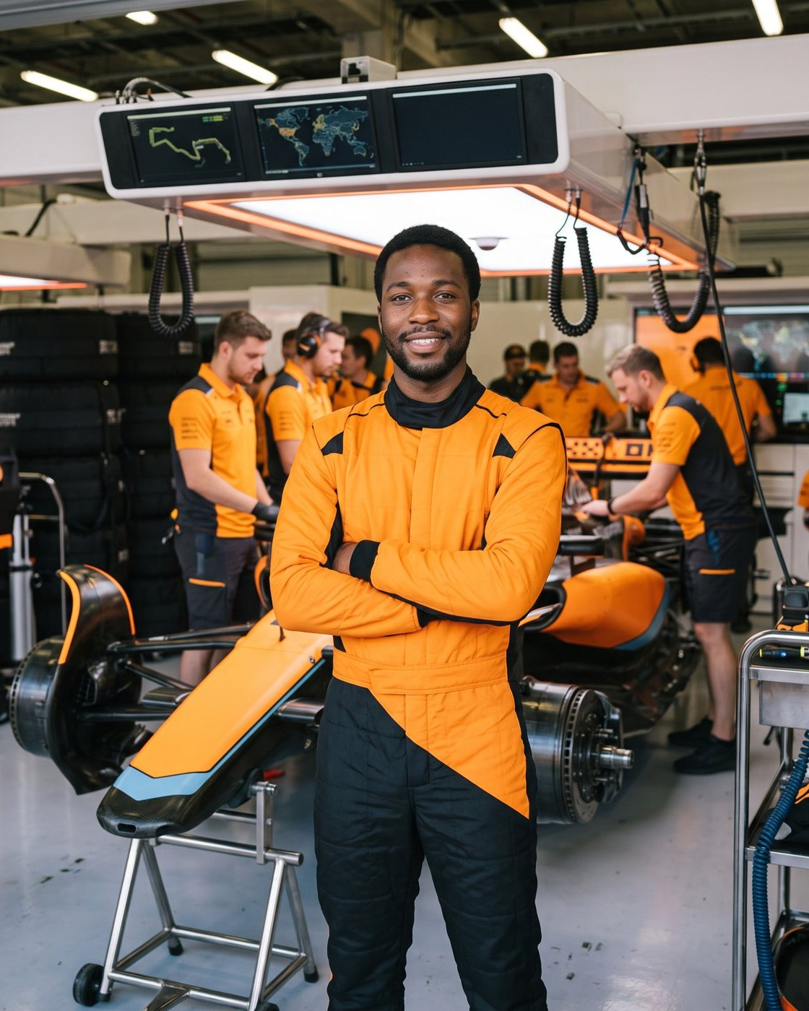
LET’S GET YOUR FANS ON THE GRID
1. Send your brand kit and official logo files
2. Pick the concepts you want to run
3. Share dates, venue and expected crowd
4. We send a custom mockup in your livery
flashbulbphotobooth.com
Notes:
Close on the custom mockup offer: send us your logos and livery and we come back with these same examples in your brand.

